Slide 1

Time series analysis

Slide 2
Time series analysis
A time series analysis involves examining data points collected or recorded at specific time intervals to identify underlying patterns, trends, and seasonal fluctuations. Through this analysis, we can detect long-term movements, periodic cycles, or irregular variations in the data.

Slide 3
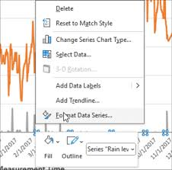
Steps time series analysis in excel
1. Prepare the Data
Collect the data: Ensure that your data is organized in two columns: one for dates/times and one for the corresponding values (e.g., sales, temperature).
Format the dates: Excel needs to recognize the time component correctly. Ensure that the date or time column is formatted appropriately (e.g., date format for dates)

Slide 4

2. Create a time series chart
.
Insert Line Chart:
Select your date and value columns
Go to the Insert tab, and click on Line Chart under the Charts section. This creates a basic line chart showing your data trends over time.

Slide 5

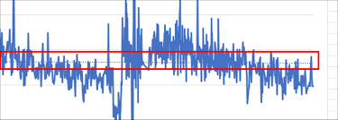
3. Calculate moving averages
Simple Moving Average (SMA)
In an empty column, use the following formula to calculate the moving average (e.g., for a 3-period moving average):
=AVERAGE(B2:B4)

Slide 6

4.Decompose the time series
Time series decomposition involves splitting the series into three components: trend, seasonality, and noise.
Trend: Use Excel's Trendline feature to identify the trend. Select your chart, click on a data point, and choose Add Trendline.
Seasonality: You can manually identify seasonality by calculating average values for each time period

Slide 7
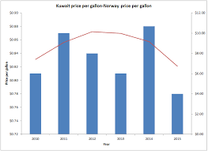
5.Forecasting
Using the Forecast Function: The formula is:
=FORECAST.LINEAR(x, known_y's, known_x’s)
X - is the point you want to forecast.
known_y's - are the historical data (values).
known_x’s - are the corresponding dates or periods.
Data Analysis Toolpak:
Go to File > Options > Add-ins and enable the Analysis Toolpak.
Then go to Data > Data Analysis and select Moving Average for forecasting.

Slide 8
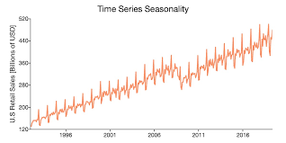
6. Seasonality adjustments
If your data exhibits seasonality, you can adjust the values using seasonal indexes or factors derived from previous years. Calculate the seasonality factor by dividing the actual values by the moving average or trendline values.

Slide 9
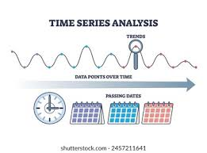
7. Performing regression analysis
Regression analysis is a useful tool to understand the relationships between time and the observed variable:
Go to Data > Data Analysis > Regression
Select the time periods as the independent variable and the observed values as the dependent variable.
Excel will return a summary output with regression statistics, coefficients, and the equation.

Slide 10
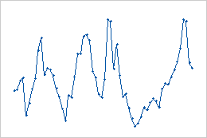
8. Autocorrelation analysis
You can use autocorrelation to check the relationship between the data points and their lags:
Calculate the correlation between the original data and the data shifted by one or more time periods using Excel’s CORREL function.

Slide 11
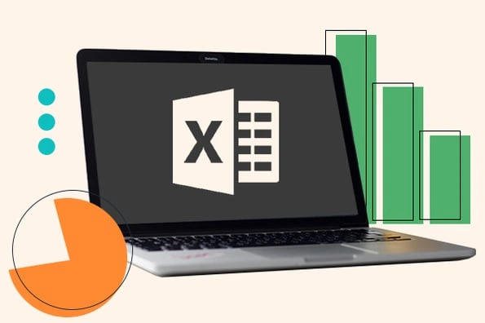
9. Visualization with power BI or pivot charts
If you want more interactive time series analysis and visualization, you can export the data to Power BI or use Excel’s PivotCharts for dynamic visualizations.

Slide 12
Conclusion
The insights gained from time series analysis enable businesses and researchers to forecast future values, predict outcomes, and make informed decisions. By understanding these patterns over time, organizations can better plan for the future, optimize resource allocation, and respond proactively to anticipated changes or trends.

Slide 13

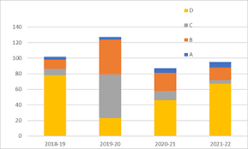

Thank you !!!
ajaycraju98@gmail.com

